Slide 1
DATA HAWK
NSCC

Slide 2
INDEX
Visualization and Analysis of Dataset
Interpretation and calculation of physical parameters
​Feature Engineering
Habitability classification

Slide 3
VISUALIZATION AND analysis

Slide 4



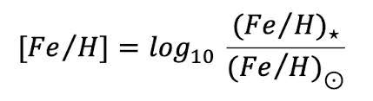
BASIC INSPECTION
MISSING VALUES
CLASS IMBALANCE
FE TO h ratio
To calculate range we didn't consider the null values.
Adding 0 will change mean and range of data.
Adding mean will change the median and deviation of data to be specific
The data was very unbalanced with around 1:100 ratio of non 0 and 0 class.
We tackled the biasedness problem using the SMOTEENN method.
Metallicity of Host Star was given in dataset using that we assumed metallicity of planet to be same the formula created a new column.

Slide 5
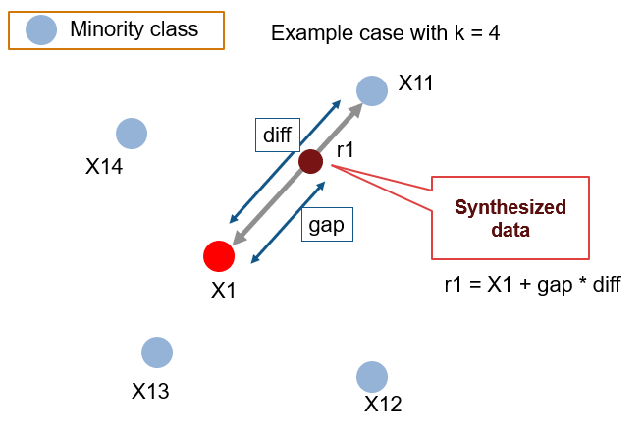
WHY SMOTEEN
Reduced Risk of Overfitting: Since SMOTE creates synthetic samples by interpolating between existing minority class samples, it introduces some degree of diversity into the dataset.
Improved Generalization: SMOTE-generated synthetic samples can provide more representative data points for the minority class, potentially improving the model's ability to generalize to unseen data.
Avoiding Data Leakage: Simple oversampling involves replicating existing data points, which can lead to data leakage if the same samples are used in both the training and validation/test sets. SMOTE generates synthetic samples independently of the original data, reducing the risk of data leakage.

Slide 6
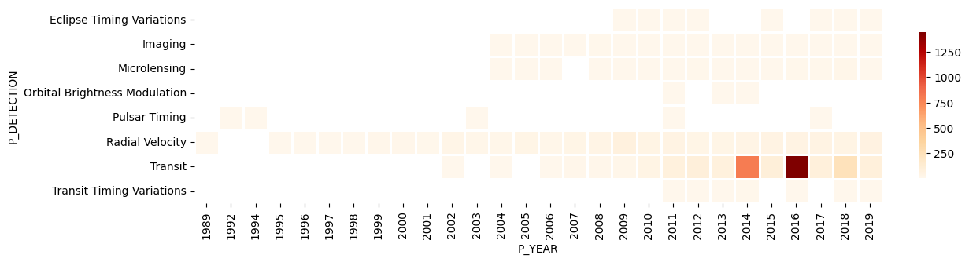
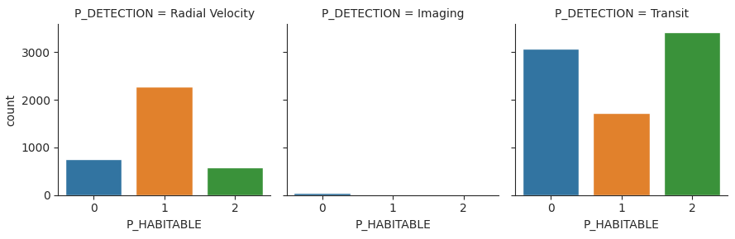
DIFFERENT METHODS
From the above heatmap we can say that
Methods such as Radial Velocity ,Transit , Imaging gave the best result.
After doing SMOTE of data to increase the count of minority classes.
Hence we see the Radial Velocity method gave most Conservatively habitable planets
But the Transit gave most Optimistically habitable planets.

Slide 7
Interpretation and calculation of physical parameters

Slide 8
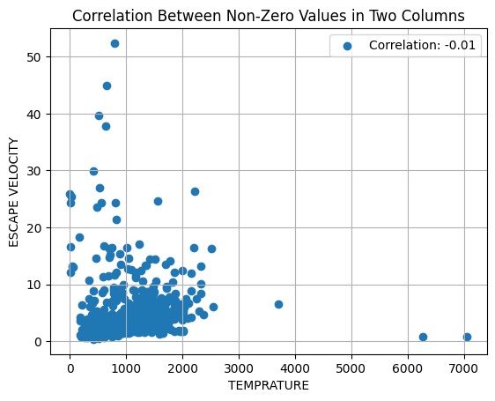
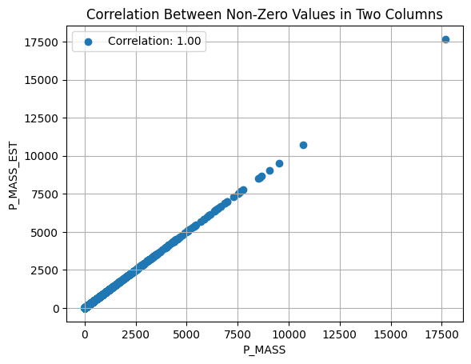
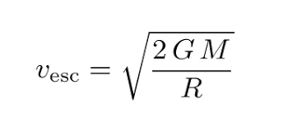
ESCAPE VELOCITY
As some data of Mass and Radius was missing from rows so used E_MASS and E_RADIUS by first checking their correlation with the P_MASS_EST and P_RADIUS_EST column.
Result
There is not much correlation between the two.
Hence we went ahead with a calculated ESCAPE VELOCITY using the EST columns using formula

Slide 9
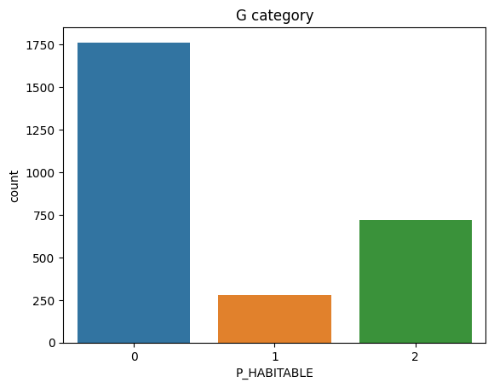
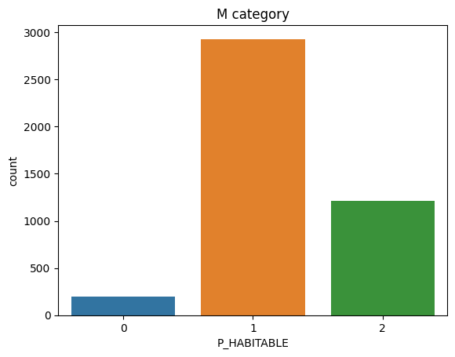
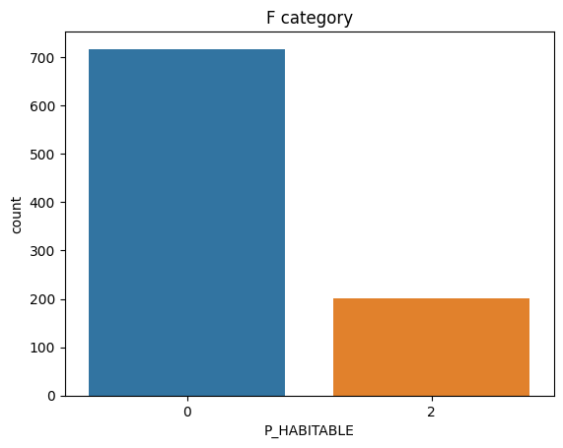
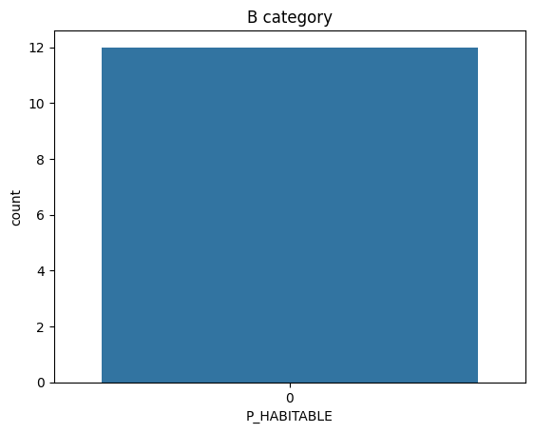
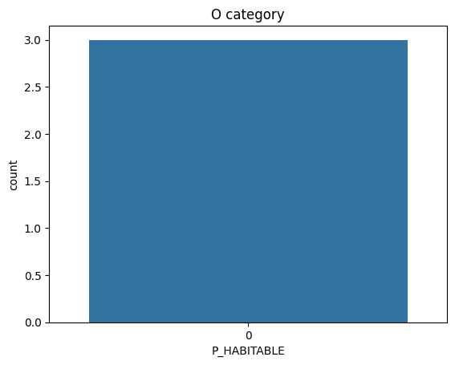
SPECTRAL TYPES
Spectral types are a classification system for stars based on their surface temperature and chemical composition.
The spectral types are represented by a letter, from O to M, with O being the hottest and M being the coolest.
There are also seven main spectral types:
O: Blue supergiants.
B: Blue giants
A: White stars
F: Yellow-white stars
G: Yellow stars (like the Sun)
K: Orange stars
M: Red dwarfs
The habitability of a planet is determined by a number of factors, including its distance from its star, its atmosphere, and its composition. However, the spectral type of the star can also play a role.

Slide 10
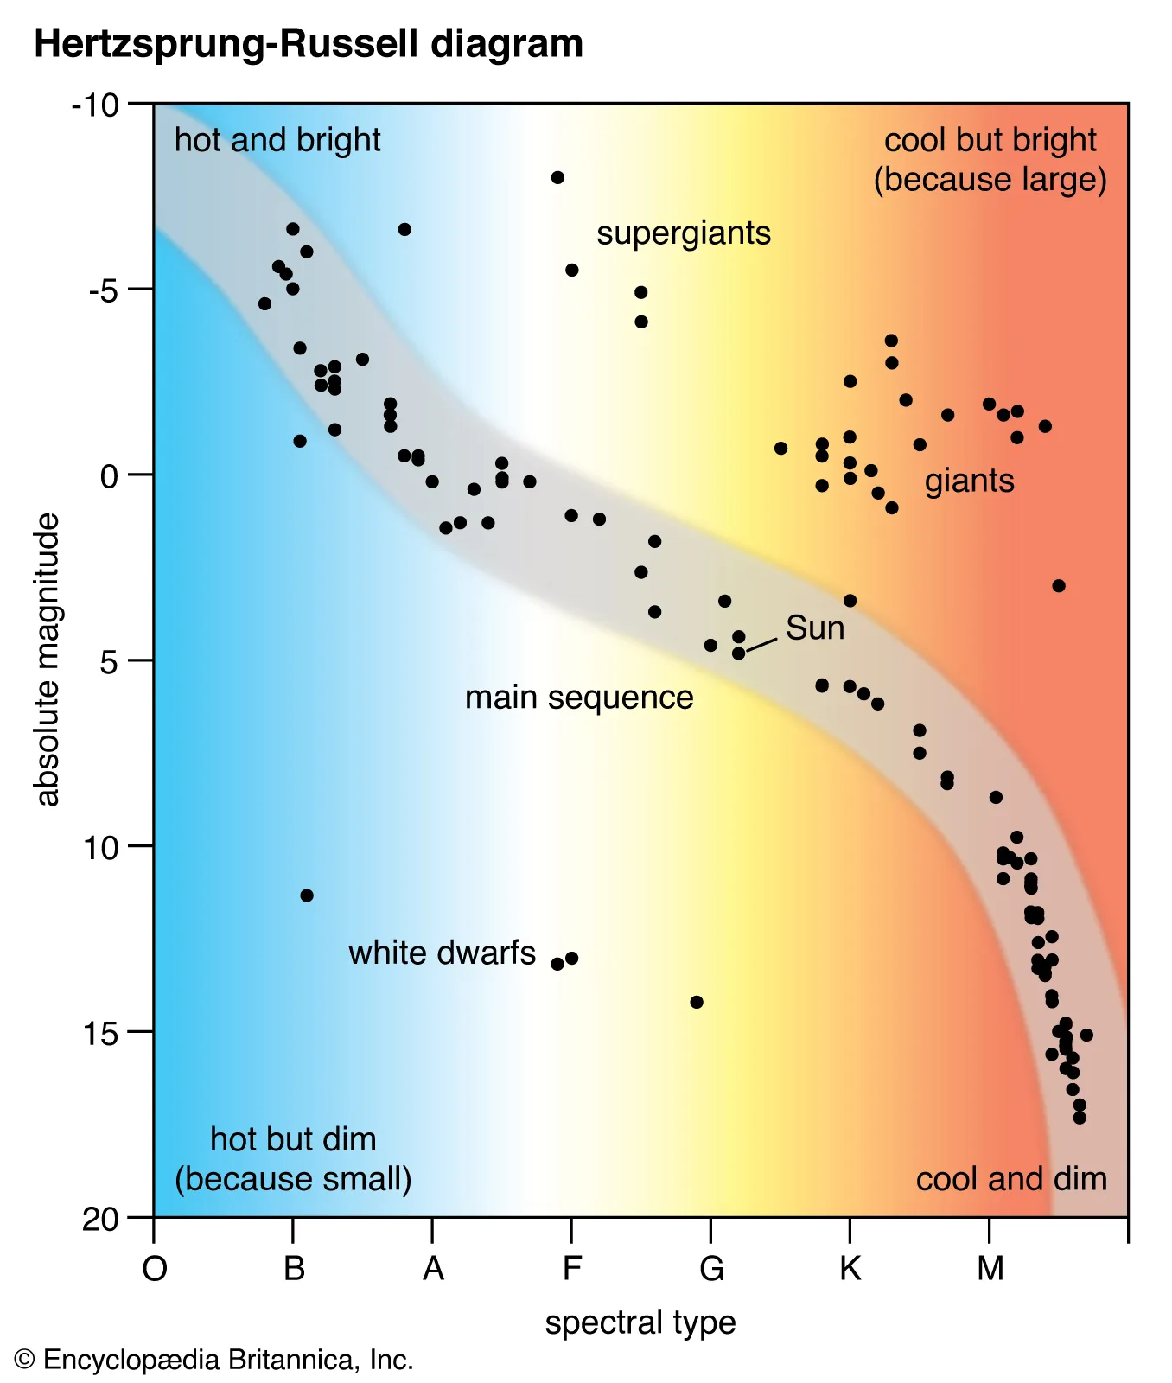
The reasons for the plot obtained can be explained by the knowledge gained regarding star spectral types.
O and B spectral types stars are very hot and have strong stellar winds. These winds can strip away the atmospheres of planets that orbit too close, making them uninhabitable.
A spectral
Stars are less hot and have weaker stellar winds. This makes them more likely to have habitable planets.
F spectral
Stars are similar to A spectral type stars, but they are slightly cooler. This means that they are also less likely to have habitable planets.
G spectral
Stars are the most common type of star in the Milky Way galaxy. They are also the most likely to have habitable planets. This is because they are not too hot or too cold, and they have the right amount of mass to support life.
K spectral
Stars are cooler than G spectral type stars, but they are still warm enough to support life. They are also more likely to have habitable planets than M spectral type stars.
M spectral
Stars are the coolest and least massive stars. They are also the most common type of star in the universe. However, they are less likely to have habitable planets because they are too cool.

Slide 11
Feature engineering

Slide 12
Visualizing Null Values
There is a significant number of null values present in almost all the columns. Visualization of the density of null values in every column is done using a heatmap. The threshold of removing columns is set to 40%, i.e., all the columns that have more missing values than 40% of the total rows are eliminated. Since, we do not have adequate amount of information about the column as 40% of the total values are missing, we cannot come up with a confident solution to impute those missing values.

Slide 13
Heat Map representing null values

Slide 14
Next, all the categorical data is encoded to numerical data using Label Encoder so that they can be handled along with the numerical columns and machine learning models can be implemented. Now, the null values remaining in the dataset is imputed using a technique called MICE (Multivariate Imputation by Chained Equations). This technique was used because MICE make an educated guess about true values of missing data by looking at other data samples.
Handling null values and categorial columns
.
.

Slide 15
Mice Imputer
.
.
.
To elaborate more on this here's how MICE imputation works:
Initialization: Start with the dataset containing missing values. Each missing value is initialized with an estimated or imputed value, often using simple methods like mean imputation.
Iterative Imputation: The process consists of multiple iterations, typically repeated until convergence or for a specified number of iterations. In each iteration, one variable with missing values is selected as the "target" variable, and the missing values in that variable are imputed using a predictive model.
Predictive Models: For each target variable, a predictive model is built using the other variables in the dataset (both those with and without missing values). The choice of predictive model can vary and may include linear regression, logistic regression, decision trees, or other machine learning algorithms, depending on the nature of the variables.
Imputation: Once the predictive model is trained, it is used to impute the missing values in the target variable. The imputed values are inserted into the dataset.
Cycle Through Variables: After imputing one variable, the process cycles to the next variable with missing values, and the same steps are repeated. This continues until all variables with missing values have been imputed. The order in which variables are imputed can be random or based on a predefined sequence.
Repeat Iterations: Steps 3 to 5 are repeated for a predefined number of iterations or until some convergence criteria are met. In each iteration, the imputed values may become more accurate as the model's predictions are refined.
MICE was chosen for imputation in our dataset because it incorporates information from all available variables when imputing each missing value. It can produce accurate imputations even when the relationships between variables are complex or nonlinear.

Slide 16
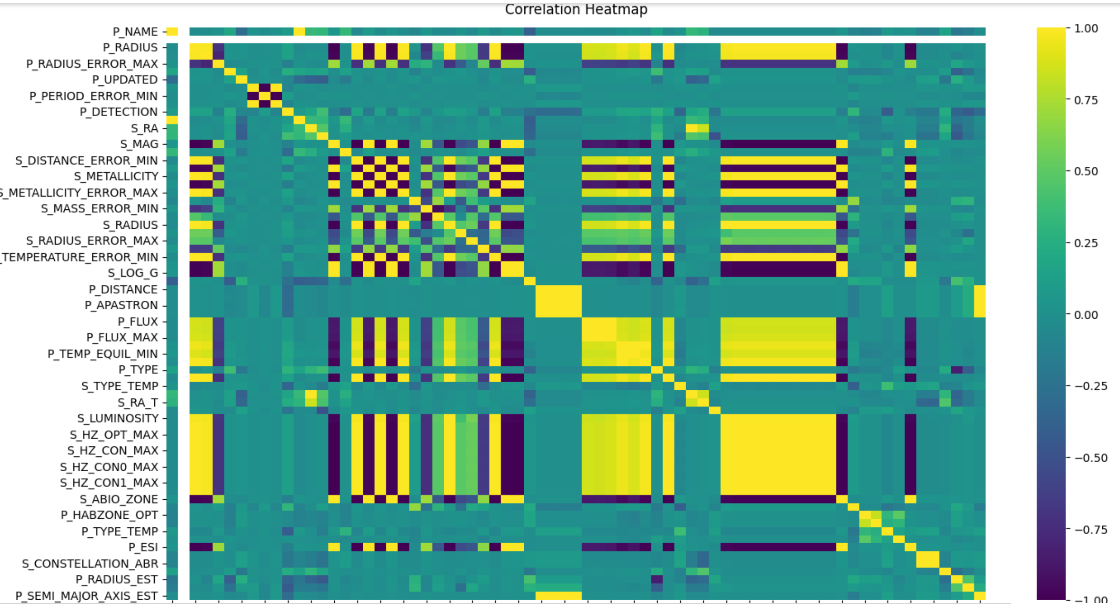

Observing Correlation map
ROI
Envision multimedia-based expertise and cross-media growth strategies
Visualize quality intellectual capital
Engage worldwide methodologies with web-enabled technologies

Slide 17
Inferences from the map
Next, the heatmap for person correlation is observed. It is observed that the predictor components have correlations of more than 0.95 in some cases, this concludes thar the information obtained is duplicated. Some of them are:
P_SEMI_MAJOR_AXIS_EST, P_DISTANCE, P_APASTRON, P_DISTANCE_EFF
P_FLUX, P_FLUX_MAX, P_FLUX_MIN
P_TEMP_EQUIL, P_TEMP_EQUIL_MAX, P_TEMP_EQUIL_MIN
S_RA, S_RA_H
S_RADIUS, S_RADIUS_EST, S_HZ_OPT_MIN, S_HZ_OPT_MAX, S_HZ_CON0_MIN, S_HZ_CON0_MAX, S_HZ_CON1_MIN, S_HZ_CON1_MAX, S_SNOW_LINE
It is worth keeping only one of each group.
The columns with the coordinates of the Star are removed too because that does not give information of habitability rather just location: S_RA, S_RA_H, S_DEC, S_RA_T, S_DEC_T
By the feature engineering implied till now, the number of columns is reduced to 49 from 112. Almost all the wasteful and redundant features have been removed.
Observing the heatmap, it is inferred that P_HABITABLE which confirm the exoplanet as non-habitable (0), conservatively habitable (1), optimistically habitable (2) is strongly correlated to: P_HABZONE_OPT, P_HABZONE_CON, P_ESI
After refining the dataset and with the known correlations of 'P_HABITABLE' and 'P_ESI', it is accurate to say that the most important factors for habitability are: S_MAG , S_LOG_G , S_TYPE_TEMP , P_TYPE_TEMP , P_TYPE

Slide 18
Feature Engineering
The target attribute, i.e., P_HABITABLE, is dropped from our dataset so that we can have a feature matrix based on which the habitability is going to be predicted. However, there are still too many features present thus the most important ones are separated using the SelectFromModel tool from scikit learn. Three models have been used to get the most useful features and the feature that appeared in any two of the three were selected. The three models used are: Random Forests, Adaboost and Extra Trees Classifier.
The ones that were resulted in more than once in the feature selection stage: P_PERIOD, P_FLUX, P_TEMP_EQUIL, P_TYPE, P_HABZONE_OPT, P_RADIUS_EST, P_MASS_EST, S_TYPE_TEMP. These are now the features that we will work with.

Slide 19
Results from graphs
As some plots are created for visualizing the dataset. Some very interesting insights have come up. Such as –
For Planet Type, Super Terrain and Warm climate, the possibility of the planet being habitable is quite high. The possibility a planet being habitable is also when it is of the type Terran and Warm climate. Though in any other combination the possibility is almost zero.
The potency of a planet being habitant also increases when the planets semi major axis is less than 10, also when the type of temperature on the star is M or K (A bit less possibility when temperature type is K).
Habitability also increases when the value of S_MAG is near to 15 and the value of S_LOG_G is near to 4.70.

Slide 20
Habitability classification

Slide 21
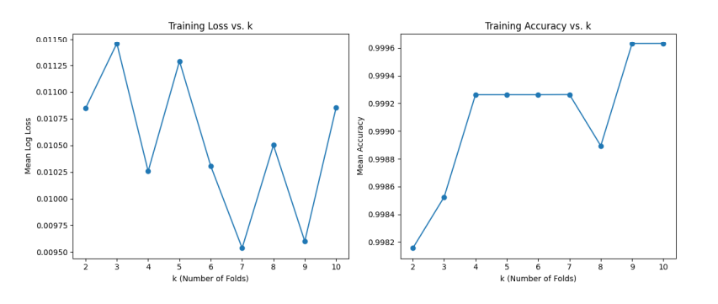
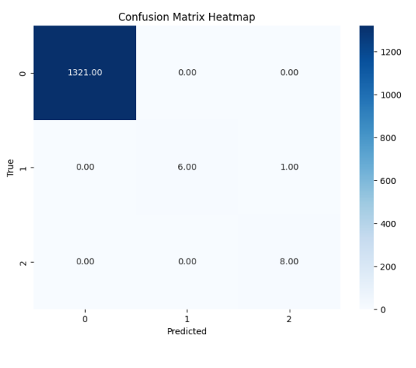
Extra Trees Classifier
Best hyperparameters:
n_estimators: 200,
min_samples_leaf’: 5
max_features: 3
Accuracy : 0.999099002833296

Slide 22
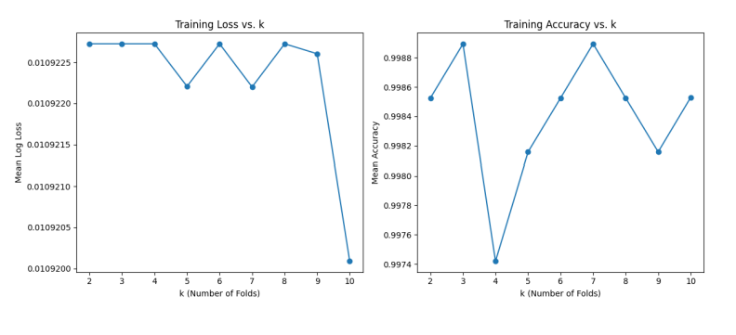
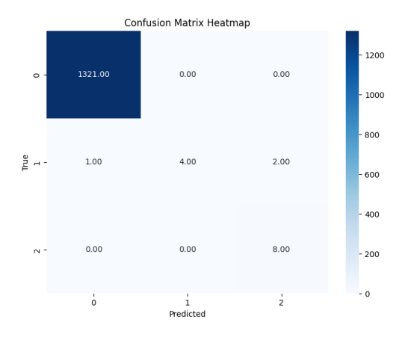
XGBoost Classifier
Best hyperparameters
Subsample : 0.7999999999999999,
num_class : 10,
n_estimators : 500
, max_depth : 150
learning_rate: 0.2
colsample_bytree: 0.8999999999999999
colsample_bylevel: 0.7
Accuracy: 0.9984030519646642

Slide 23
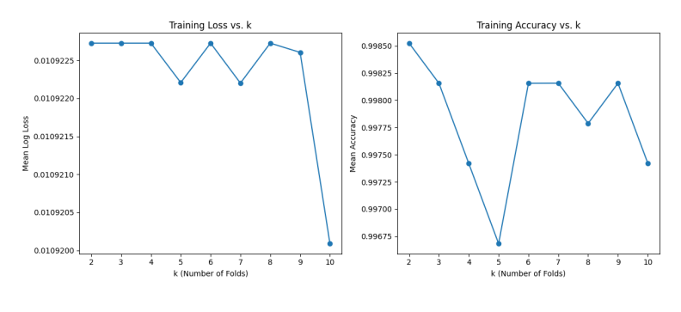
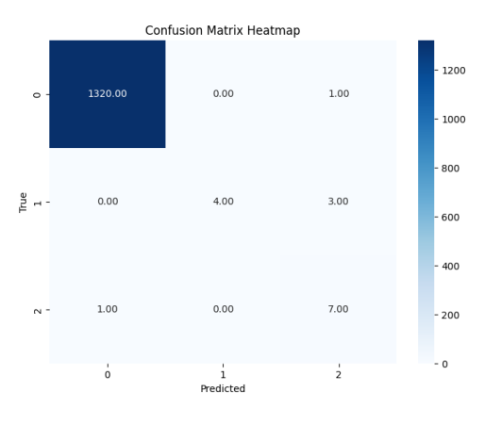
Random Forest Classifier
Best hyperparameters
n_estimators : 4
min_samples_split : 10
min_samples_leaf: 1
max_features : 'sqrt’,
max_depth: 100,
bootstrap: False
Accuracy: 0.997829061803788

Slide 24
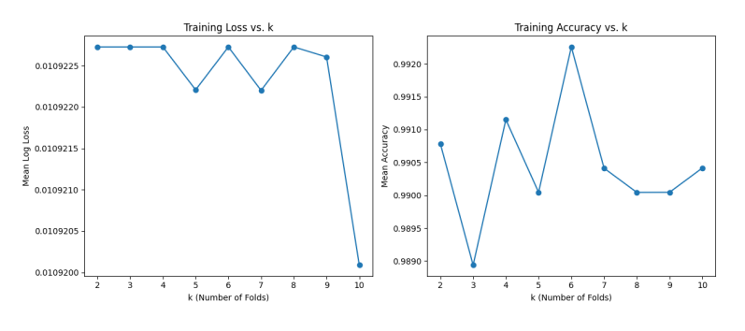
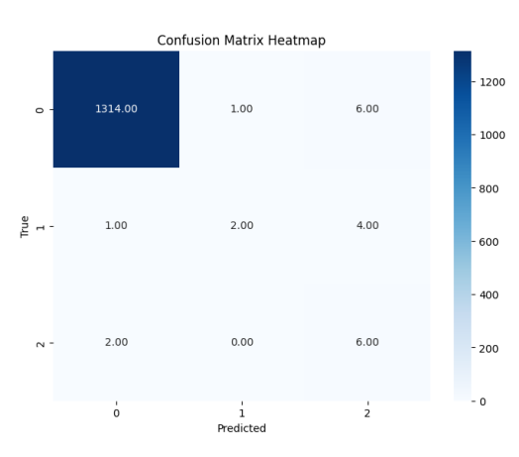
KNN Classifier
Best hyperparameters
weights : distance
p: 1
n_neighbors : 7
leaf_size : 30
algorithm: auto
Accuracy: 0.9904541680684292

Slide 25
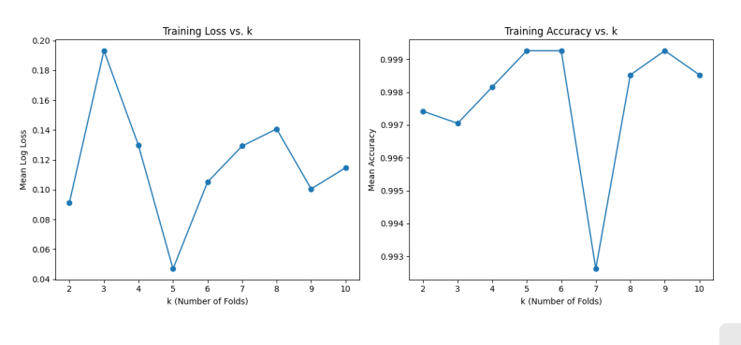
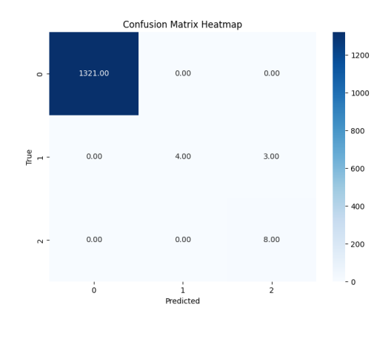
ADABOOST Classifier
Accuracy: 0.997787366570274

Slide 26
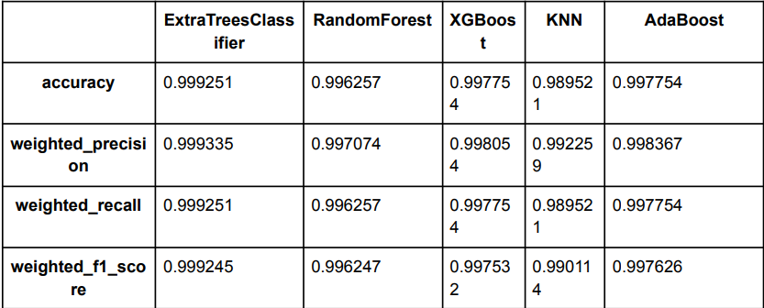
CONCLUSION
Best hyperparameters:
n_estimators: 200,
min_samples_leaf’: 5
max_features: 3
Accuracy : 0.999099002833296

Slide 27




TEAM
AVINANDAN SHARMA
AYUSH KUMAR
SRIJAN RANJAN
SUBARNO MAJI​

Slide 28
THANK YOU

